Slide 1
Module 2

Slide 2
Contents
Data to Insights to Decisions Data Exploration
Visualization with R
Installing and loading tidyverse,
Loading and examining a Dataset
Grouping and summarizing a dataset
Plotting a dataset

Slide 3
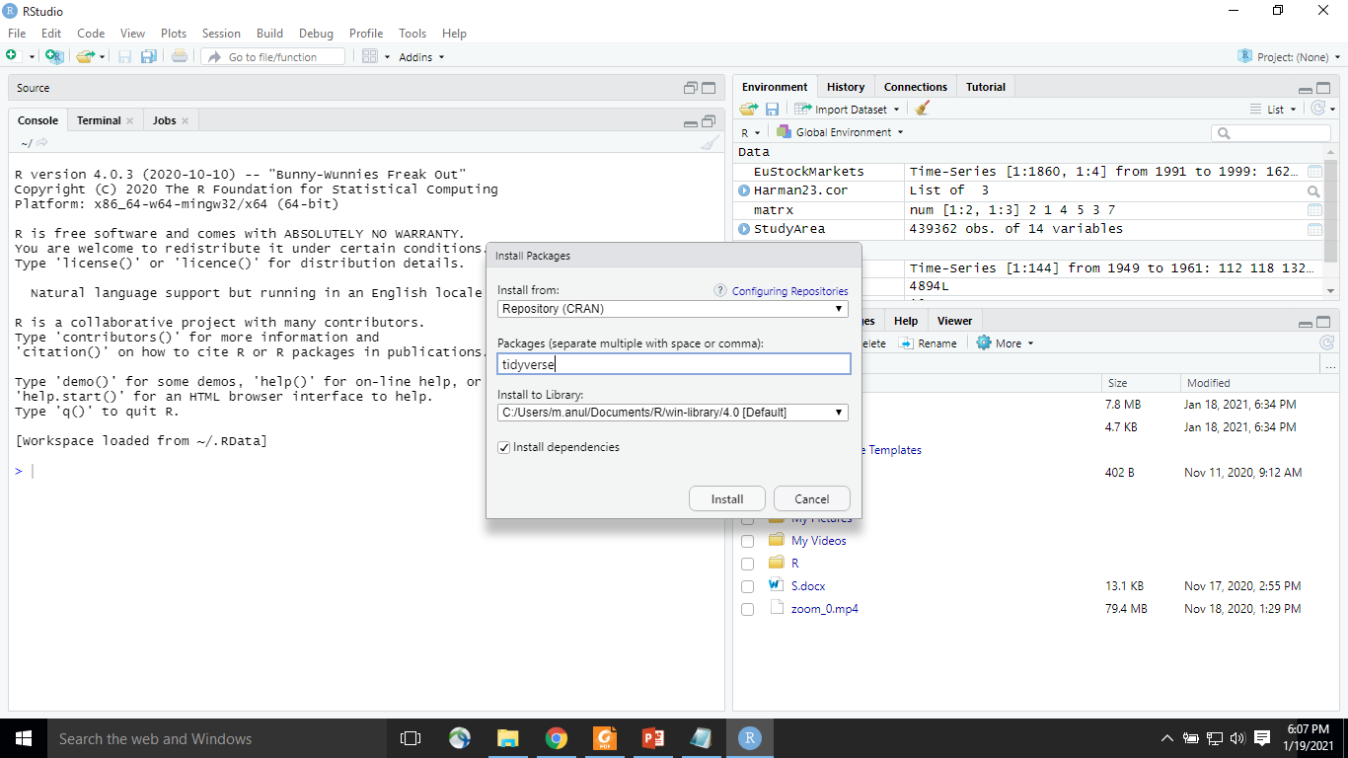
Exercise:1 Install Tidyverse
Go to tools and click on install packages and type Tidyverse

Slide 4
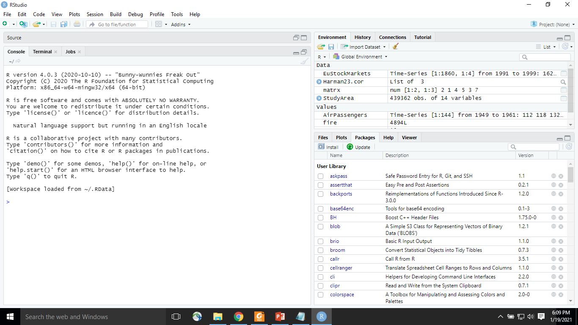
Install Tidyverse
Or

Slide 5
Exercise 2: Loading and examining a dataset
The tidyverse package is designed to work with data stored in an object called a Tibble.
Tibbles are the tidyverse implementation of a data frame.
They are quite similar to data frames, but are basically a newer, more advanced version.
Tibbles never convert the data types of variables. Also, they never change the names of variables or create row names.
Tibbles also have a refined print method that shows only the first 10 rows, and all columns that will fit on the screen.
Tibbles also print the column type along with the name.

Slide 6
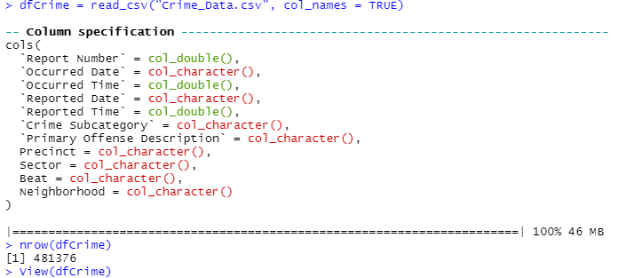
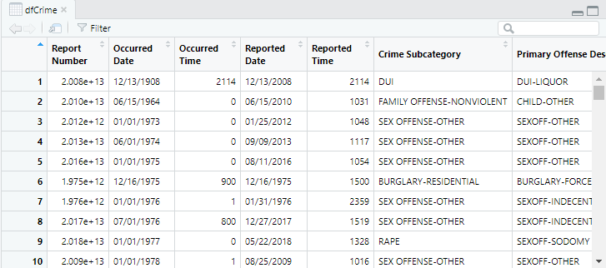
Exercise 2: Loading and examining a dataset
We will read the contents of a CSV file using the read_ csv() function found in the readr package

Slide 7
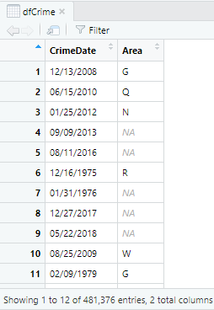
Exercise 2: Loading and examining a dataset
The dplyr package includes a select() function that can be used to limit the fields in the data frame.
In the Packages pane, load the dplyr library. Again, if you don’t see the dplyr library then it (or the entire tidyverse) will need to be installed.
We can limit the columns to the following: Reported Date, Sector, & Beat
dfCrime=select(dfCrime, 'Reported Date', 'Sector', 'Beat')
The select() function can be used to rename the columns
dfCrime=select(dfCrime, 'CrimeDate' = 'Reported Date',
'Area'='Sector')

Slide 8

Exercise 3: Filtering a dataset (Start)
Filtering the dataset enables you to focus on a subset of the rows instead of the entire dataset.
The dplyr package includes a filter() function for filtering.
dfCrime2 = filter(dfCrime, Neighborhood == 'GREENWOOD')
You can use View(dfCrime2) to view the filtered data
nrow(dfCrime2) to know the number of rows

Slide 9
Exercise 4: Grouping and summarizing a dataset
The group_by() takes an existing table and converts it into a grouped table where operations are performed "by group".
The group_by() function, found in the dplyr package, used to group data by one or more variables.
Once grouped, summary statistics can then be generated for the group or you can visualize the data in various ways.
E.g. the crime dataset we’re using could be grouped by offense, neighborhood and year and then summary statistics including the count, mean, and median number of burglaries by year generated.
It’s also very common to visualize these grouped datasets in different charts (charts, scatterplots, or other graphs).
You can use ungroup() removes grouping. ungroup(x, ...)

Slide 10
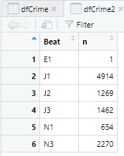
Exercise 4: Grouping and summarizing a dataset
To group the crimes by police beat
dfCrime2 = group_by(dfCrime2, Beat)
The n() function is used to get a count of the number of records for each group dfCrime2 = summarise(dfCrime2, n = n())
Use the head() function to examine the results. head(dfCrime2)

Slide 11

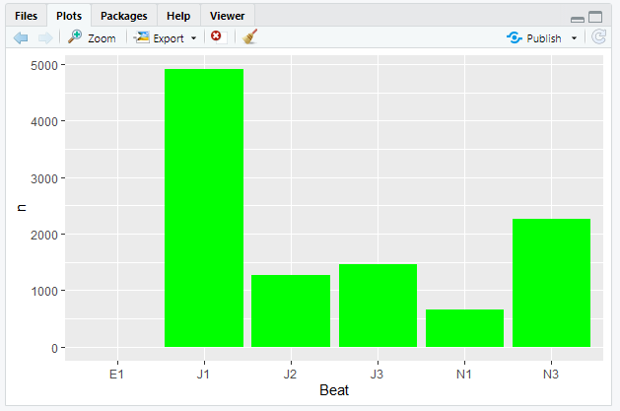
Exercise 5: Grouping and summarizing a dataset Plotting a dataset
The ggplot2 package can be used to create various types of charts and graphs from a data frame
The first parameter passed to ggplot() will be the data frame you want to plot. Or it can also be a subset() of a data

Slide 12
Exercise 6: Graphing burglaries by month and year
1. In the RStudio Packages pane, load the lubridate package.
Load the crime data from the Crime_Data.csv dfCrime = read_csv("Crime_Data.csv", col_names = TRUE)
Specify the columns and column names dfCrime = select(dfCrime, 'CrimeDate' = 'Reported Date', 'Category' = 'Crime Subcategory', 'Description' = 'Primary Offense Description', 'Precinct','Sector','Beat','Neighborhood')
Filter the records so that only residential burglaries in the Queen Anne neighborhood are retained. dfCrime2 = filter(dfCrime, Neighborhood == 'QUEEN ANNE', Category == 'BURGLARY-RESIDENTIAL')

Slide 13
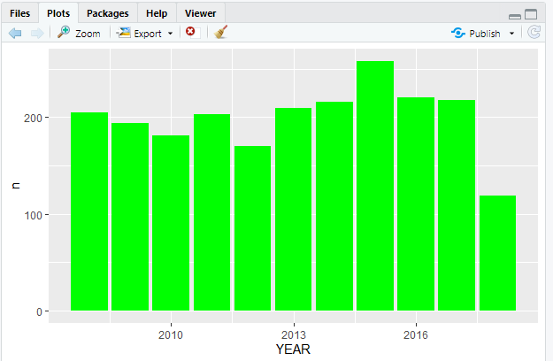
Exercise 6: Graphing burglaries by month and year
The mutate() function is used to create the new columns. Here the mutate() function will be used to extract the year from the CrimeDate column. dfCrime3 = mutate(dfCrime2, YEAR = year(as.Date(dfCrime2$CrimeDate,format='%m/%d/%Y')))
View(dfCrime3)
dfCrime4 = group_by(dfCrime3, YEAR) dfCrime4 = summarise(dfCrime4, n = n())
View(dfCrime4)
ggplot(data=dfCrime4) + geom_col(mapping
= aes(x=YEAR, y=n), fill="green")

